Slide 1

CS320
Computer Security
(Access Control)
Dr. Raouf Khan

Slide 2
Objectives of the Lecture
This lecture aims to
Define Access Control
Describe Access Control Principles
Define and Explain the Three Major Categories of Access Control Policies (DAC, MAC and RBAC)

Slide 3
Access Control Definition and Principles
Access control: the prevention of unauthorized use of a resource, including the prevention of use of a resource in an unauthorized manner.
Access control involve the following entities and functions:
Authentication: verification that the credentials of a user or other system entity are valid.
Authorization: the granting of a right or permission to a system entity to access a system resource. This function determines who is trusted for a given purpose.

Slide 4
Access Control Elements
The basic elements of access control are:
Subject
Object
Access Right
a) Subject: is an entity capable of accessing objects. Any user or application actually gains access to an object by means of a process that represents that user or application. The process takes on the attributes of the user, such as access rights.

Slide 5
Access Control Elements cont.
There are three classes of subject:
Owner: the creator of a resource (e.g. file).
Group: in addition to the privileges assigned to an owner, a named group of users may also be granted access rights, such that membership in the group is sufficient to exercise these access rights. In most schemes, a user may belong to multiple groups.
World: the least amount of access is granted to users who are able to access the system but are not included in the categories owner and group for this resource.

Slide 6
Access Control Elements cont.
b) Object: is a resource to which access is controlled. An object is an entity used to contain and/or receive information (e.g. records, files, directories, directory trees, mailboxes, and programs).
c) An access right: describes the way in which a subject may access an object.
Access rights could include the following:
Read: view information in a system resource. This access include the ability to
Write: add, modify or delete data in a system resource. It include read access.
Execute: Users execute specific programs.
Delete: users may delete certain system resources such as files.
Create: users may create new files or records.
Search: users may list the files in a directory or search the directory.

Slide 7
Access Control Types
Access control policies are grouped into the following categories:
1. Discretionary access control (DAC): controls access based on the identity of the requestor and on access rules (authorizations) stating what requestors are (or are not) allowed to do.
This policy is termed discretionary because an entity might have access rights that permit the entity, by its own volition (self decision or choice), to enable another entity to access some resource.

Slide 8
Access Control Types
2. Mandatory access control (MAC): controls access based on comparing security labels (which indicate how sensitive or critical system resources are) with security clearances (which indicate system entities are eligible to access certain resources).
This policy is termed mandatory because an entity that has clearance to access a resource may not just by its own volition, enable another entity to access that resource.

Slide 9
Access Control Types
3. Role-based access control (RBAC): controls access based on the roles that users have within the system and on rules stating what accesses are allowed to users in given roles.
4. Attribute based Access control (ABAC): Controls access based on attributes of the user, the resource to be accessed, and current environmental conditions.

Slide 10
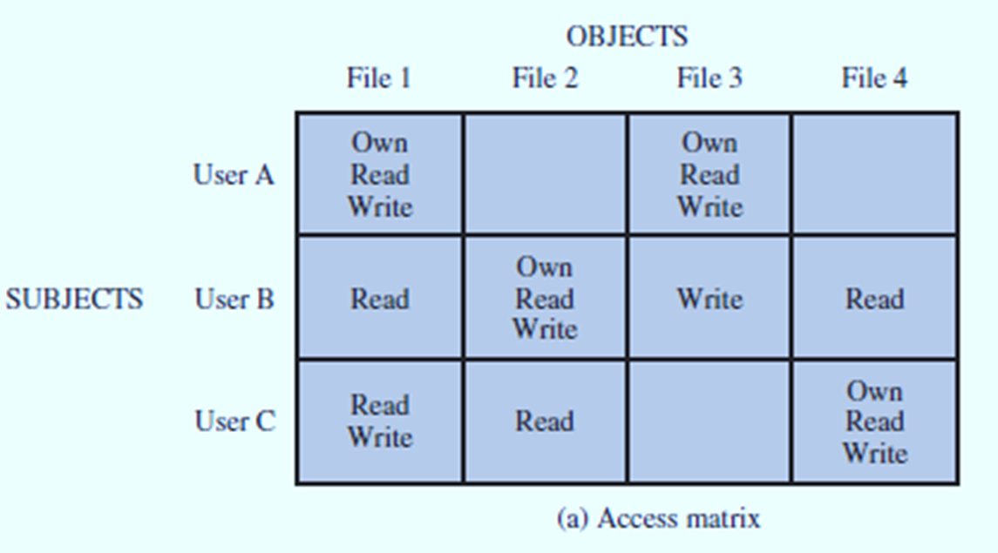
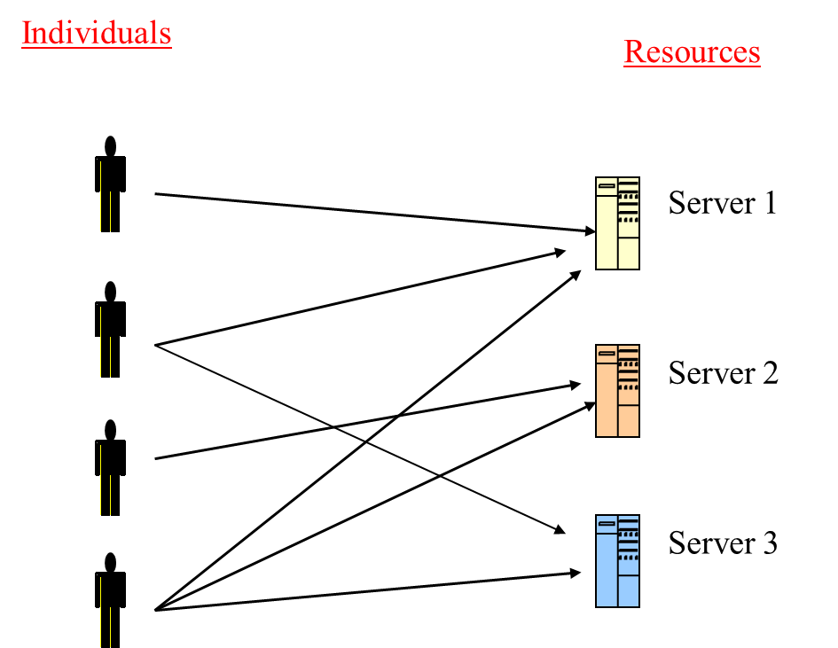
Discretionary access control (DAC)
An access matrix is a general approach to DAC.
An access matrix consists of identified subjects, objects and access rights.
Each entry in the matrix indicates the access right of a particular subject for a particular object.

Slide 11
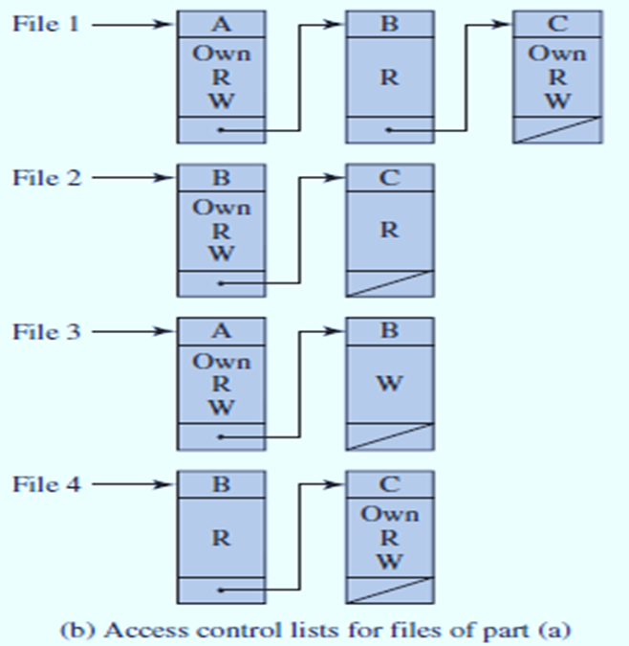
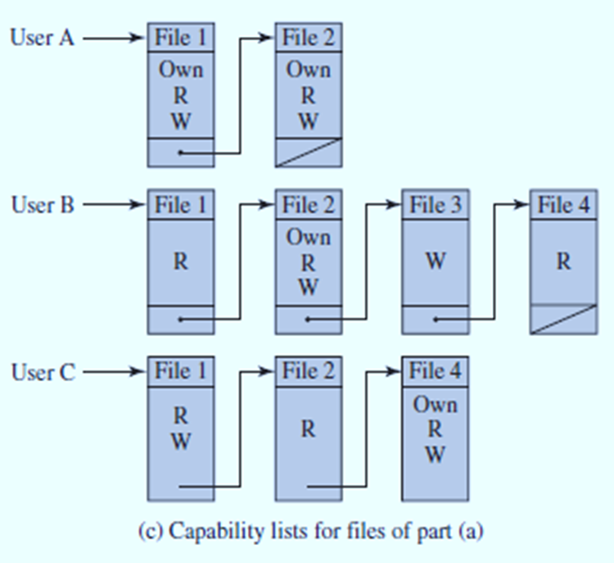
Discretionary access control (DAC) Cont.
The access matrix may be decomposed by columns, yielding Access Control Lists (ACLs ).
The access matrix may be decomposed by rows, yielding Capability Tickets.

Slide 12

Discretionary access control (DAC) Cont.
Different types of DAC are
Ownership: If you create a file, you are the owner of the file. The file header contains your ID. Only you can change or read the file, others have no access.
File types and file protection classes: you create a file and assign a file type or a file protection class.
You may define a file as a public, semipublic or private file
For example following choices for a file protection class can be used
Class File Type description
Blank public anyone can r/w the file
@ exe. only anyone can run the prog only owner & admin can r/w
$ read only anyone can read / execute only owner & adm. can write
# private only owner /admin can r/w or execute the file
A-z system dependent if profile contains class P, is allowed to access PAYROLL
files. ( protected with class of P)

Slide 13
Discretionary access control (DAC) Cont.
III) Self / Group / Public controls
In many systems , you control access to your files by dividing the world of users into three categories and telling the system what the users in each category can do to your file.
Some systems call them Self /group / public control and in UNIX they are known as User/group/others

Slide 14
Discretionary access control (DAC) Cont.
IV) File Permission: Each file has a set of bits called file permissions associated with it
For example
_RW_RW_R__ 1 Khan R&D 81940 oct1 12:00 UPDATE
Khan can read & write , R & D group can read & write , others can only read… the file UPDATE file created by Khan on 1 oct at 12 noon.
_rwxrwxrwx 1 Salim Games 61255 May 22 11:32 CHESS
Owner salim , the group games and others can read, write and execute the Chess file.
_RW_RW_ _ _ _ Ahmad Acounts 55634 aug 31 10:10 PAYROLL
Owner ahmad & the group can read & write no one else can read write or execute the file payroll

Slide 15
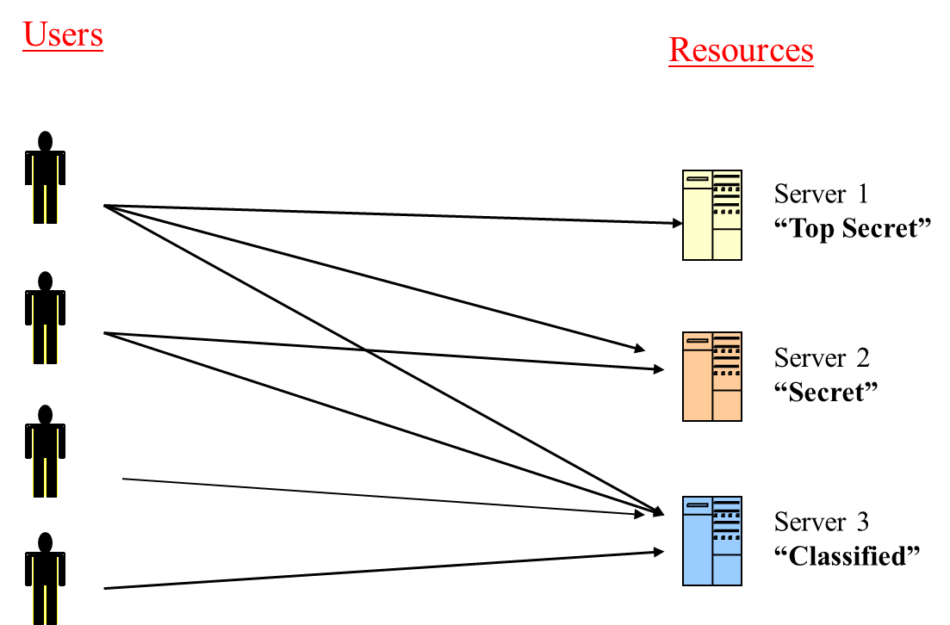
Mandatory Access Control (MAC)
MAC mechanisms assign a security level to all information, assign a security clearance to each user, and ensure that all users only have access to that data for which they have a clearance.
MAC protects your data and make restrictions based on the security clearance.

Slide 16
Mandatory Access Control (MAC) Cont.
Systems providing MAC must assign sensitivity labels to all subjects ( users, programs) and to all objects ( files, directories, devices, etc)
MAC uses sensitivity labels ( i.e. level of trust) to determine who can access what information.
Sensitivity labels consists of two parts
1. A classification
2. A set of categories or compartments
The classification is single, hierarchical level
The categories or compartments are non-hierarchical

Slide 17
Mandatory Access Control (MAC) Cont.
Access decisions
To Read : To read an object the subject sensitivity level must Dominate, i.e. equal to or exceed the object sensitivity level, in addition the categories you are allowed to read must include the categories specified in the file label
To Write: To write an object, the object sensitivity level must Dominate. i.e. your sensitivity level must be equal or less than the sensitivity level of the file and your categories must all be included in the file categories list.

Slide 18

Mandatory Access control (Cont.)
Top secret[venus, alpha, tank]
Mohamad
Secret [venus, alpha]
Read but can’t write
Can’t read but write
file
Haya
Can Read & write
Secret[alpha]
Ahmad
Secret[venus, alpha]

Slide 19
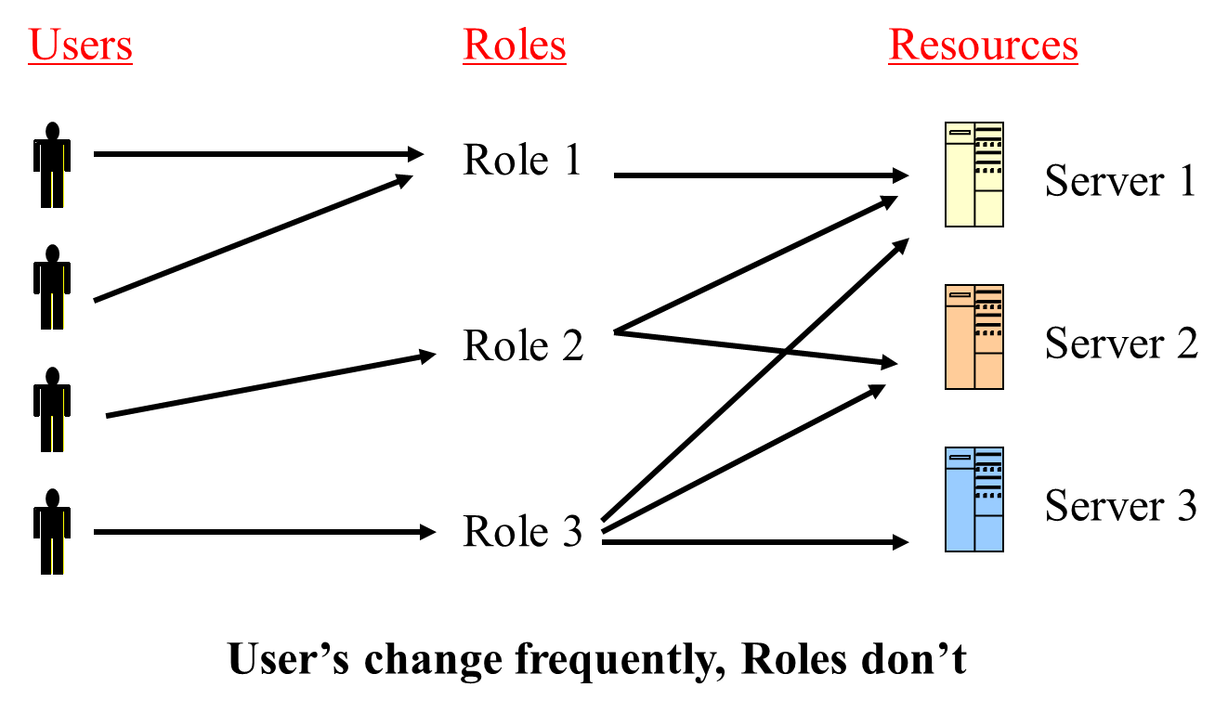
Role Based Access Control (RBAC) Cont.
RBAC is based on the roles that users assume in a system rather than the user’s identity.
A role is defined as a job function within an organization.
Each role may have specific access rights to one or more resources.
A users is assigned to a role that enable to perform only what is required for that role.

Slide 20
Role Based Access Control (RBAC) Cont.
Access Control Lists ( ACL’s)
They are the lists of users & groups with their specific permission.
Normally implemented differently on different systems
For example in UNIX based system, you’d protect PAYROLL with ACL,s in the form
< Ahmad. Actt , r >
It means if Ahmad is in actt. group he can read the file if he is in any other group he can’t access the file. Similarly
<mohammad. Pay , rw > means if mohammad is in pay group he can read & write the file but if he is not in pay group he cant access the file.
< * . * , r > any user in any group can read the file.
< @ . * , rw > only owner (@) of the file can r/w
< sami . * , none > or < sami . * , null > means sami in any group cannot access the file.

Slide 21
Attribute Based Access Control (ABAC)
ABAC is the concept of policies that express a complex Boolean rule set that can evaluate many different attributes.
Policies: bring together attributes to express what can happen and is not allowed.
Attributes
Subject Attributes
age, clearance, department, role, job title.
Action (Rights) Attribute
read, delete, view, approve
Object Attribute
the object type (medical record, bank account…), the department, the classification or sensitivity, the location
Contextual (environment)
attributes that deal with time, location or dynamic aspects of the access control scenario

Slide 22
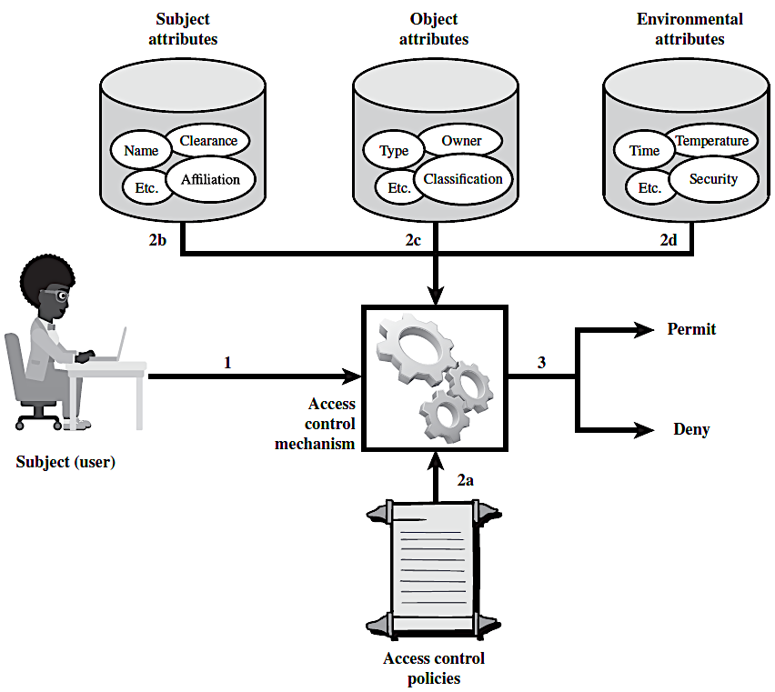
Attribute Based Access Control (ABAC) Cont.
How it works?
It controls access to objects by evaluating rules against:
The attributes of entities (subject and object),
Operations, and
The environment relevant to a request.
It finally either permit or deny access to the requested object/s.

Slide 23
Attribute Based Access Control (ABAC) Cont.
The previous figure indicates that
An access by a subject to an object proceeds according to the following steps:
A subject requests access to an object. This request is routed to an access control mechanism.
The access control mechanism is governed by a set of rules (2a) that are defined by a preconfigured access control policy.
Based on these rules, the access control mechanism assesses:
the attributes of the subject (2b),
object (2c), and
current environmental conditions (2d).
The access control mechanism grants the subject access to the object if access is authorized, and denies access if it is not authorized.

Slide 24
Attribute Based Access Control (ABAC) Cont.
ABAC Policies
A policy is a set of rules and relationships that govern allowable behavior within an organization.
This is based on the privileges of subjects and how resources or objects are to be protected under which environment conditions.
The privileges represent the authorized behavior of a subject;
The privileges are defined by an authority and embodied in a policy.
Note: Policy is typically written from the perspective of the object that needs protecting, and the privileges available to subjects.

Slide 25
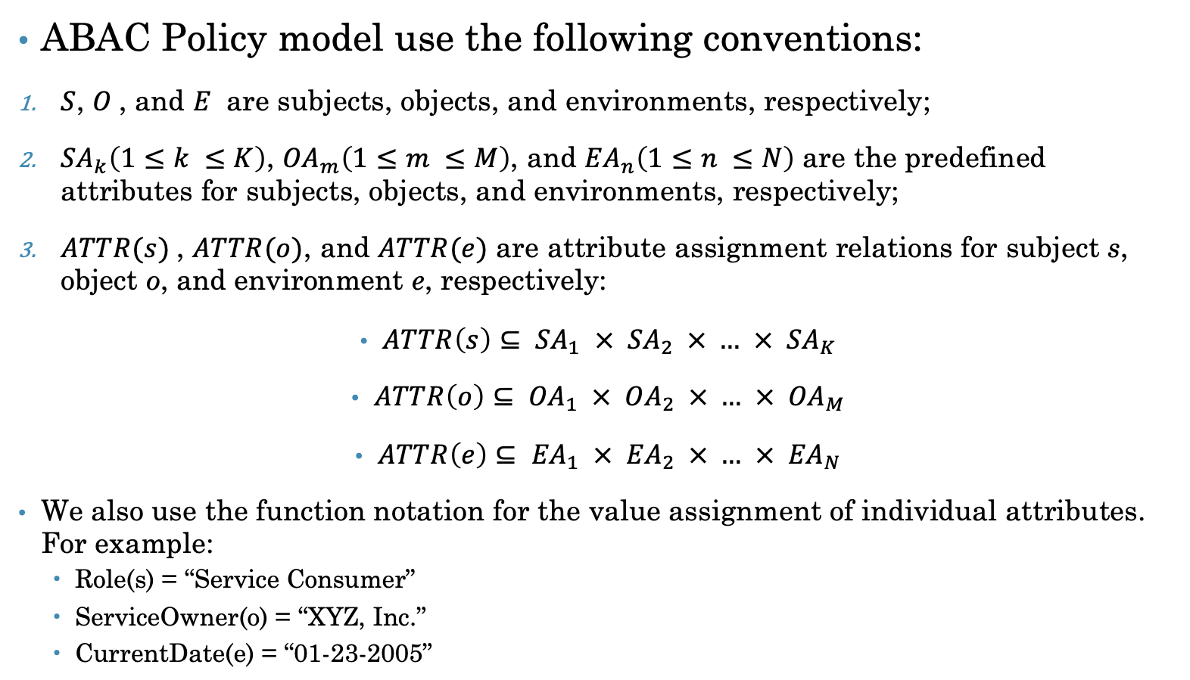
Attribute Based Access Control (ABAC) Cont.
ABAC Policy model use the following conventions:
$S$, $O$, and $E$ are subjects, objects, and environments, respectively;
${SA}_{k}\left(1≤k ≤K\right)$, ${OA}_{m}\left(1≤m ≤M\right)$, and ${EA}_{n}\left(1≤n ≤N\right)$ are the predefined attributes for subjects, objects, and environments, respectively;
$ATTR(s)$, $ATTR(o)$, and $ATTR(e)$ are attribute assignment relations for subject s, object o, and environment e, respectively:
$ATTR\left(s\right)⊆ {SA}_{1} ×{ SA}_{2} × … × {SA}_{K}$
$ATTR\left(o\right)⊆ {OA}_{1} ×{ OA}_{2} × … × {OA}_{M}$
$ATTR\left(e\right)⊆ {EA}_{1} ×{ EA}_{2} × … × {EA}_{N}$
We also use the function notation for the value assignment of individual attributes. For example:
Role(s) = “Service Consumer”
ServiceOwner(o) = “XYZ, Inc.”
CurrentDate(e) = “01-23-2005”

Slide 26
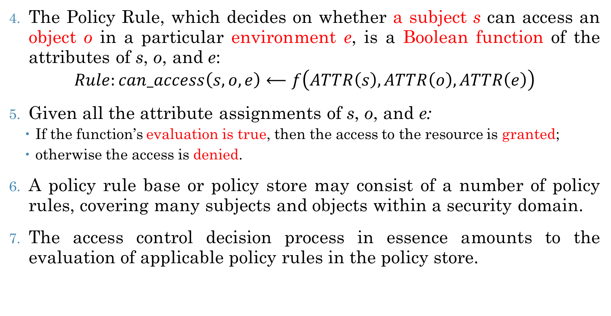
Attribute Based Access Control (ABAC) Cont.
The Policy Rule, which decides on whether a subject s can access an object o in a particular environment e, is a Boolean function of the attributes of s, o, and e:
$$Rule:can_access\left(s, o, e\right)⟵f\left(ATTR\left(s\right),ATTR\left(o\right),ATTR\left(e\right)\right)$$
Given all the attribute assignments of s, o, and e:
If the function’s evaluation is true, then the access to the resource is granted;
otherwise the access is denied.
A policy rule base or policy store may consist of a number of policy rules, covering many subjects and objects within a security domain.
The access control decision process in essence amounts to the evaluation of applicable policy rules in the policy store.

